Slide 1
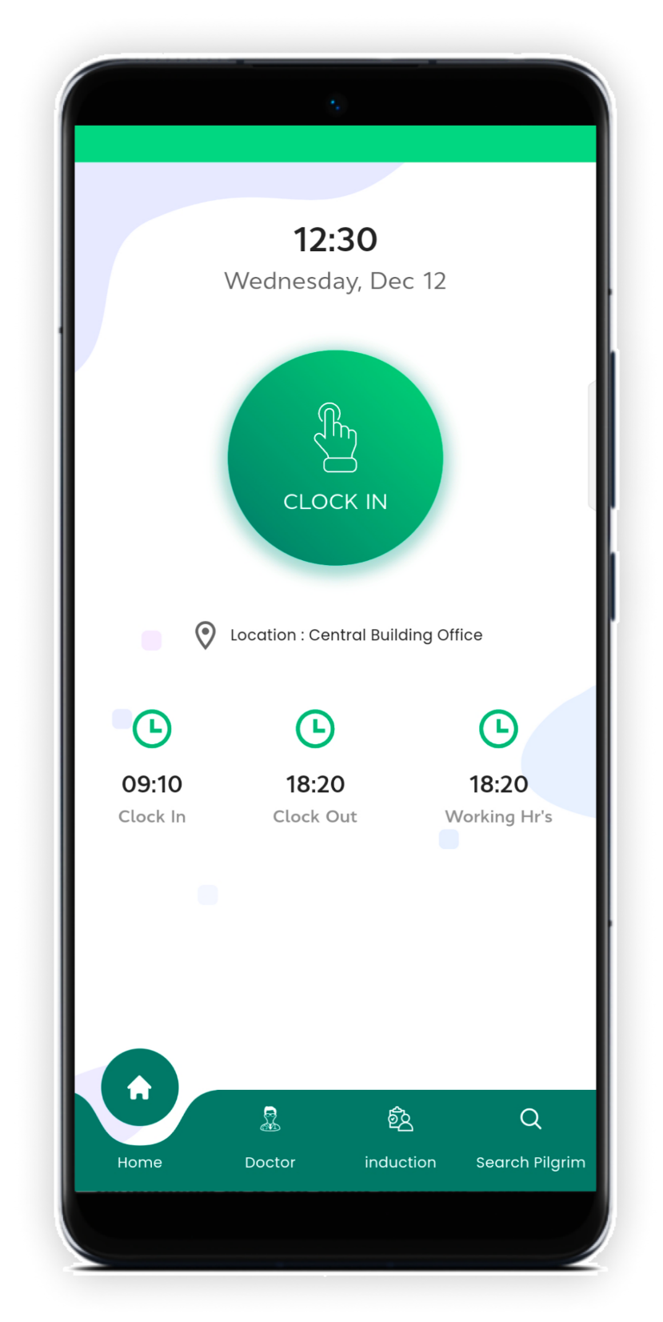
Attendance Module
for Moavineen
Develop a module to track Moavineen attendance seamlessly during Hajj proceedings, facilitating efficient monitoring of staffing and coverage throughout the event.
Implement geolocation technology to verify attendance accurately. Moavineen will only be permitted to mark their attendance when physically present at their designated duty locations.
Ensure precise staffing control by limiting attendance marking to assigned locations. This feature promotes accountability among Moavineen, optimizing overall coverage and operational effectiveness.

Slide 2
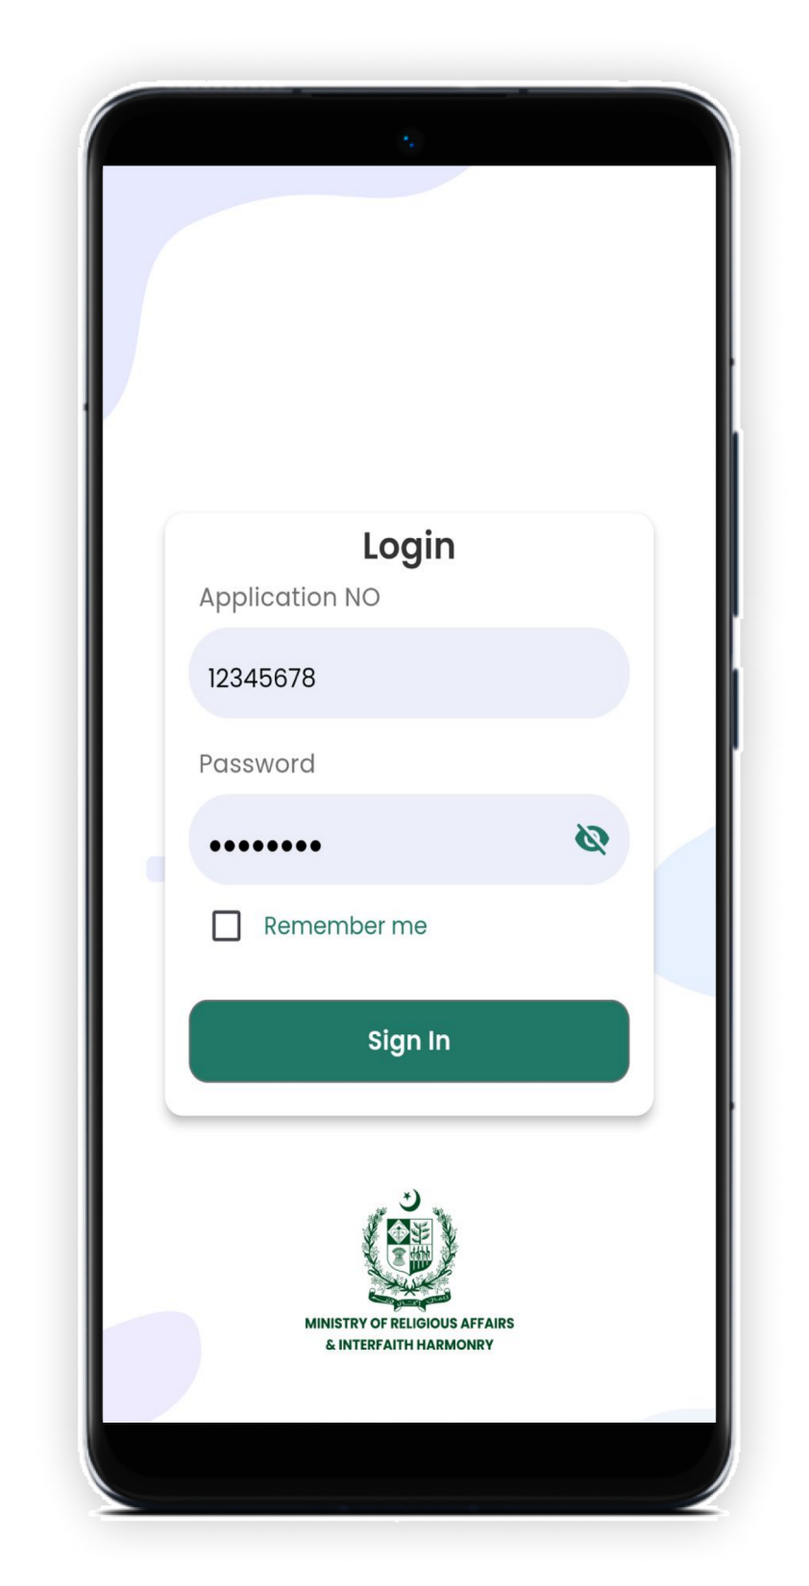
Login
Will be able to login with
given credentials

Slide 3
Check-in
User have to check-in to
mark his/her attendance
User will be only able to
check-in at designated
location

Slide 4
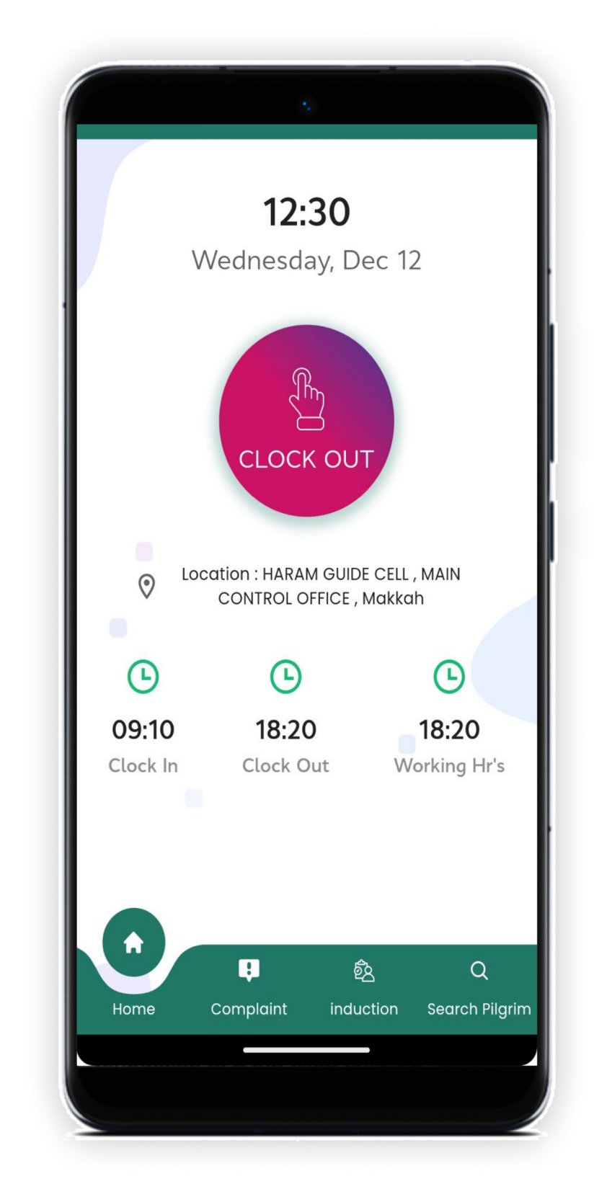
Check-out
User have to check-out to
mark his/her attendance
User will be only able to
check-out at designated
location

Slide 5
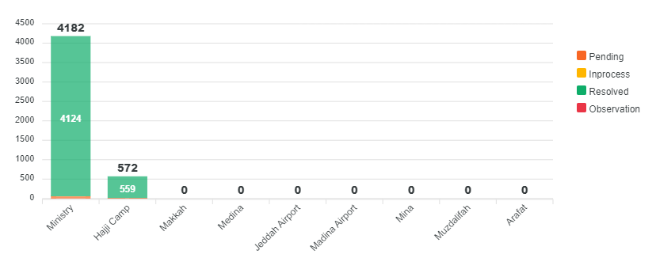
Complaint Management & Monitoring System
Haji can Directly lunch a Complain using Pak Hajj App on Clicks
Complaint location, type and sub-type can be added dynamically any time
Call center representatives can add complaints on behave of Hajis
Over 6,000 Complaints have been received and addressed since the lunch of the App
Monitoring & Resolution is on fingertips
Transparence and Decision making will be Easy

Slide 6
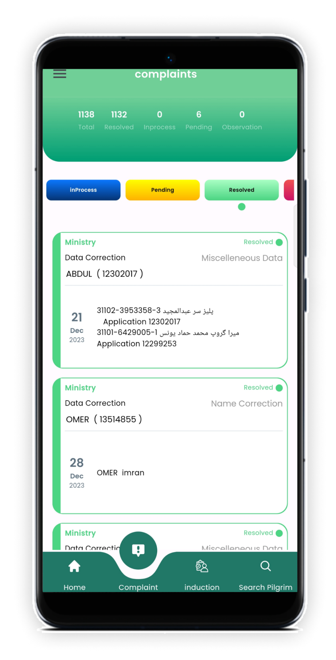
Complaint Module Integrated with Pak Hajj App
This feature integrates smoothly with the Pak Hajj app, allowing Moavineen to report and address pilgrim issues directly within the existing platform.
Pilgrim complaints appear instantly on the Moavineen app interface. When a Haji files a complaint, it immediately shows up on Moavineen devices for prompt attention.
Moavineen can quickly respond to and resolve reported concerns, ensuring a satisfactory experience for all pilgrims during Hajj. This efficient system contributes to smoother operations and enhances overall satisfaction levels.

Slide 7
CMS integration with Pak Hajj App
Launch Complaint
Display to
Action
1.Haji Directly
2. Call Center REP.
1.Ministry
2.DG Hajj
3.Director Movneen
4. Director Concern
5. Officer Concern
Officer Concern on Movneen App
History Logs
In Case of Delay
1. User End
2. Admin End
3. Overall stats updated
Complaint will be escalated through Hierarchy

Slide 8
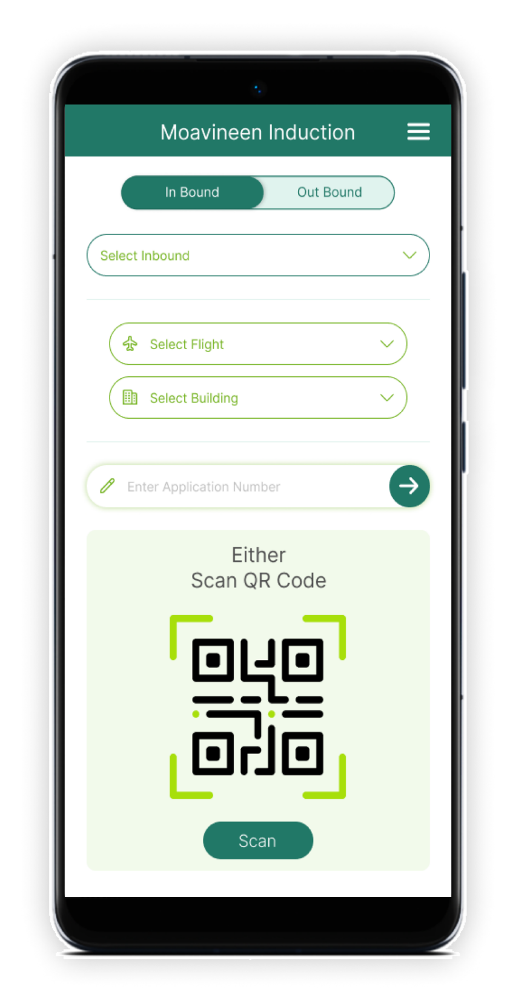
KSA Induction
Enable Moavineen to use a mobile app for Hajj pilgrim check-in/check-out at airports, buildings, and during travel between Medina and Makkah.
Integrate scanning technology into the app to verify pilgrim identities and statuses in real-time, enhancing efficiency and accuracy of monitoring.

Slide 9
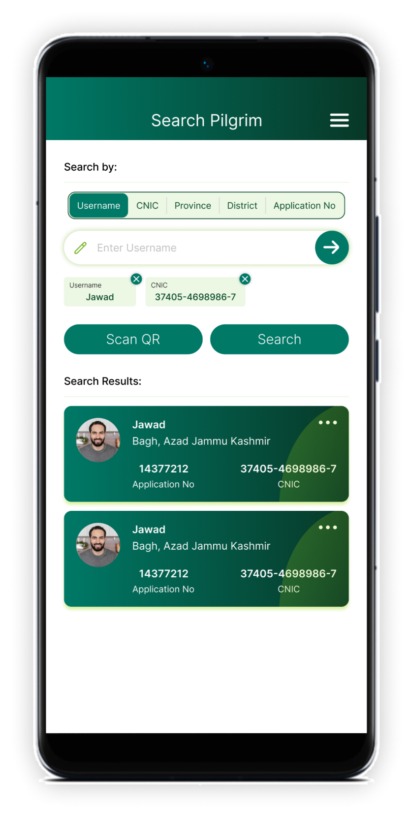
Search a Haji Module
Implement a centralized database for pilgrim profiles and travel details, allowing Moavineen to quickly access information and locate individuals in need.
Provide Moavineen with specialized training in search and rescue procedures tailored for crowded pilgrimage settings, ensuring efficient response and collaboration .

